Slide 1
Improved Low-cost pressure monitoring
footwear for to treat patients with foot anomalies

Slide 2
Aim of the product
Detecting symptoms of parkinsonism among the patients
Monitoring foot pressure of the people who had a stroke
Monitoring walking balance of the children
Detection of foot ulcers at earliest stage
Minimising the damage / amputation among the ulcer patients
Help patients receive the care they need before serious problem
Making it comfortable and affordable
Also detect other foot related complications (foot orientation and abnormalities)

Slide 3
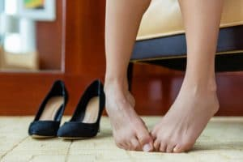
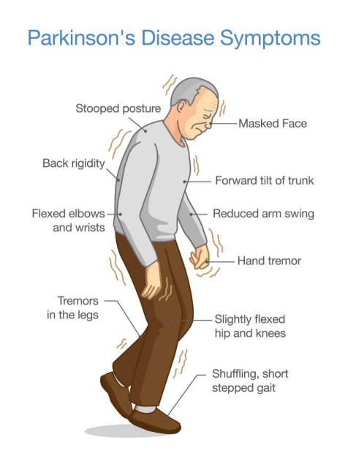
Idea of Implementation
Stroke patients clawed or hammered foot

Slide 4
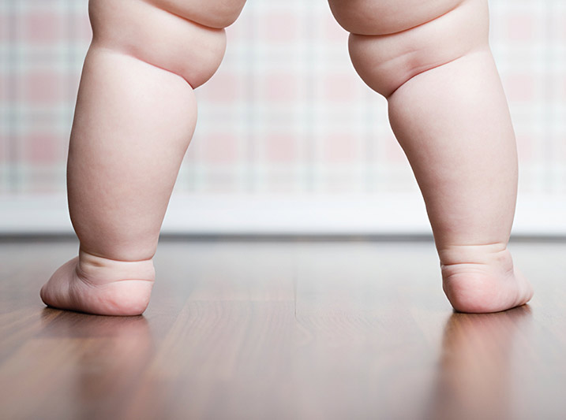
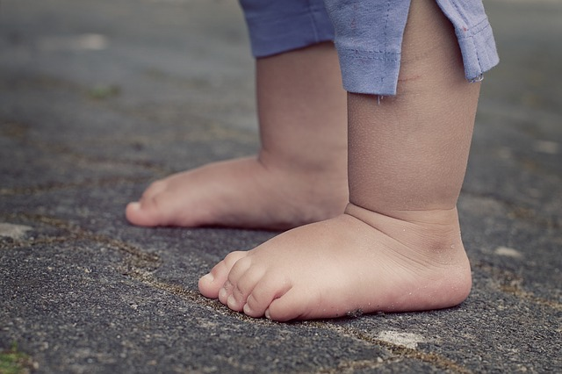
Idea of Implementation
Foot balance of babies

Slide 5
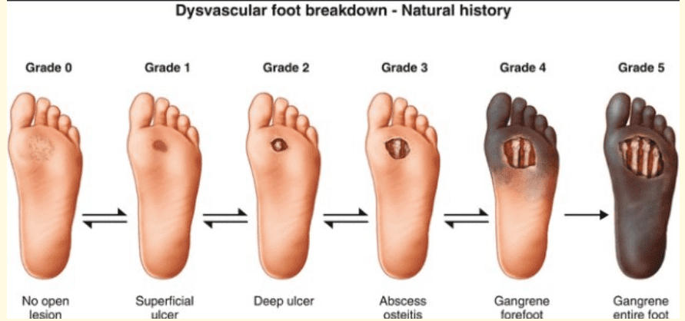
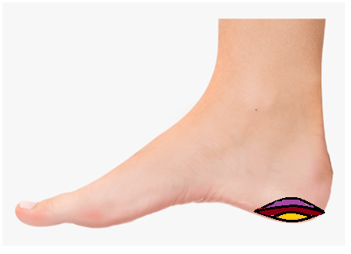
Idea of Implementation
LOW PRESSURE

Slide 6
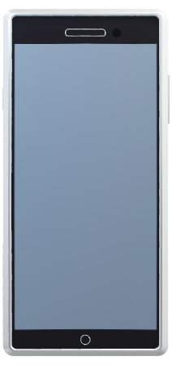

Block diagrams
Microprocessor
Application / web-server
Cloud Storage
Capacitive pressure sensors
Monitoring device

Slide 7
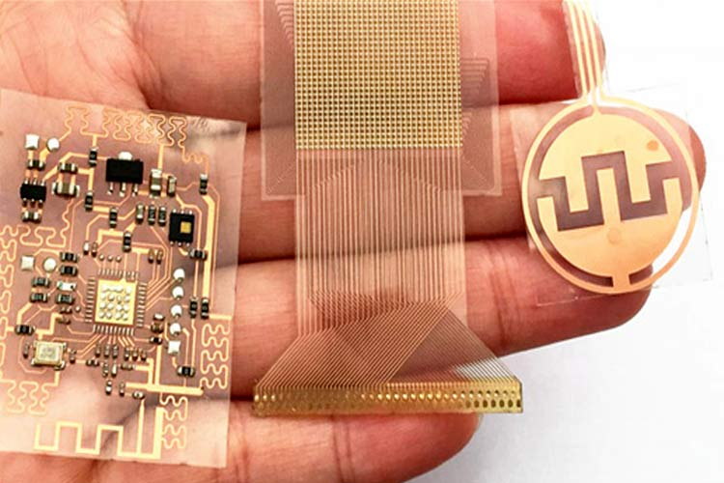
End Product
Flexible PCB (wearable)

Slide 8
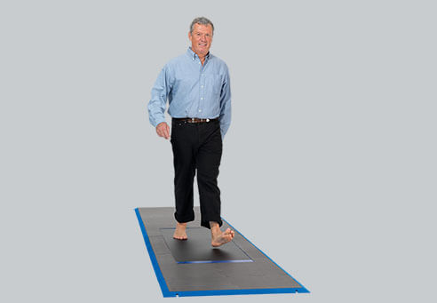
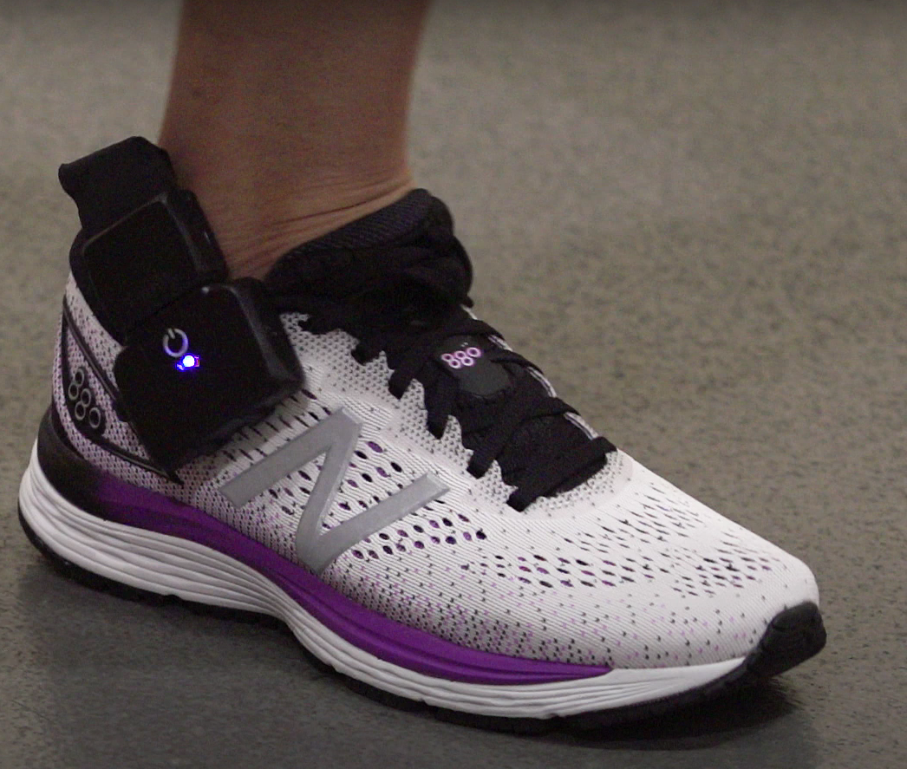
Existing products
Highly expensive products

